Slide 1
SAFETY IN THE SHOP

Slide 2
LEARNING GOALS
We can…
  Describe appropriate personal protective equipment
  Describe safety hazards associated with the shop
  Identify ways to avoid and prevent accidents

Slide 3

WHAT IS YOUR ATTITUDE TOWARD SAFETY?
Boring
“I know, I know….”
Important
“Just something to get through.”

Slide 4
ACCIDENTS
Can be caused by…
  Stress
  Illness
  Fatigue
  Lack of knowledge
  Age
  Lack of wisdom
  Poor attitude
  Drugs
  Equipment Failure
  Time of Day
  Housekeeping
Notes:
Age - Most accidental deaths at age 18 than at any other age
Time – More congested at start, lunch, and finish due to congestion

Slide 5
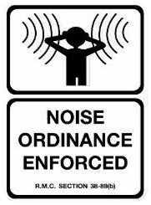
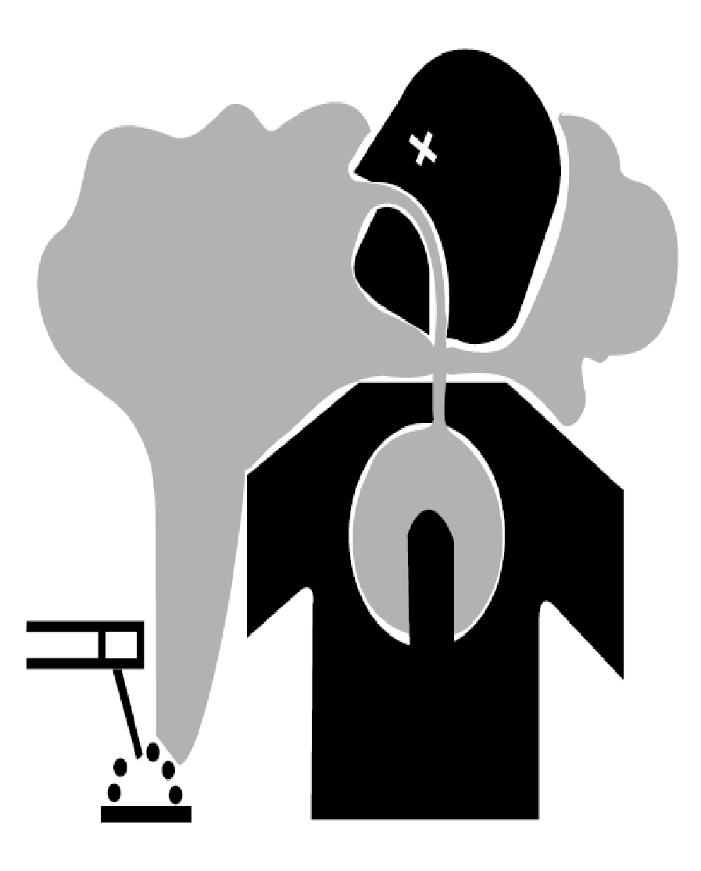



DANGERS
Air Quality
      Sharp & Moving Parts
Electric Shock
Noise
Fire

Slide 6
PERSONAL PROTECTIVE EQUIPMENT
Draw a person wearing all of the proper protective equipment for working in the wood shop. Label all pieces necessary.
You have 60 seconds.
Go!

Slide 7
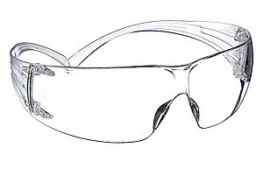
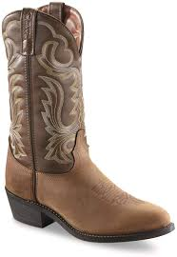
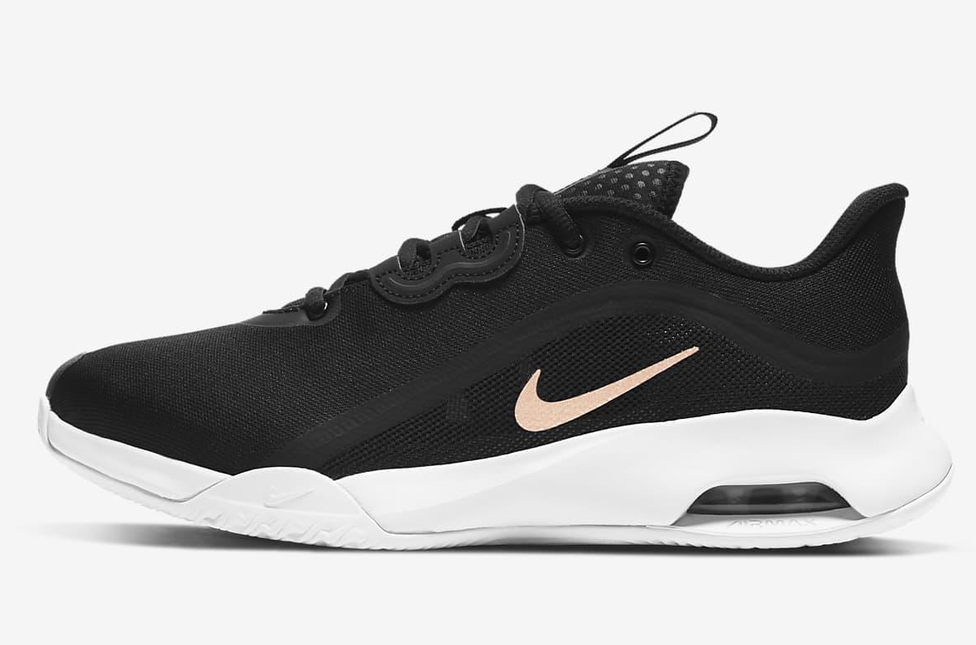
PERSONAL PROTECTIVE EQUIPMENT - REQUIRED
Safety Glasses (Z87)
Closed Toe Shoes

Slide 8
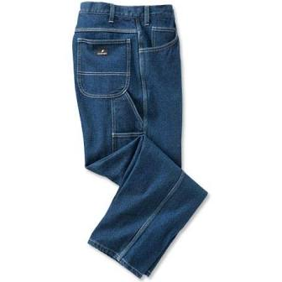
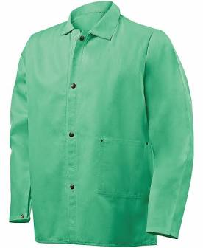
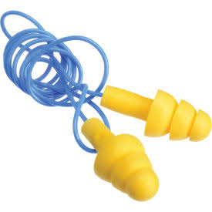
PERSONAL PROTECTIVE EQUIPMENT - RECOMMENDED
Denim Jeans
2. Long Sleeves (tight)
3. Leather Boots
4. Hearing Protection

Slide 9
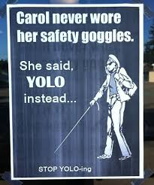

Slide 10
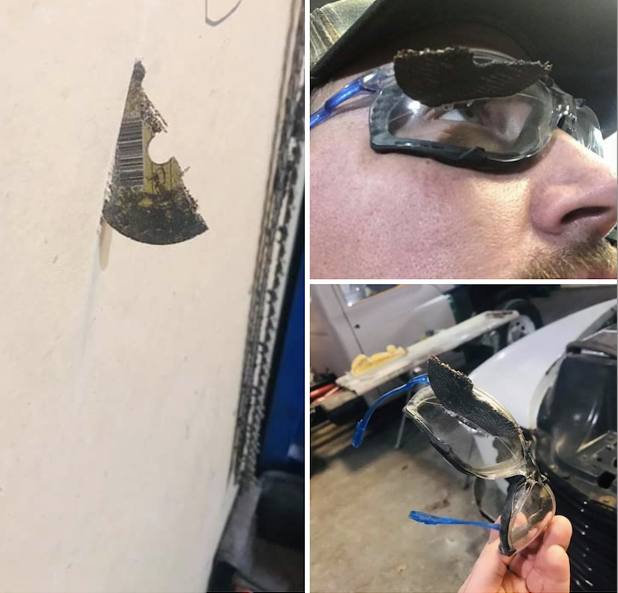

Slide 11


GO FIND IT!
Where are the safety glasses located?
Where are the ear plugs located?

Slide 12
AIR QUALITY

Slide 13

AIR QUALITY
There are two primary portions of the wo0d shop that are concerned with air quality:
1. Dust from woodworking
2. Fumes from wood finishing

Slide 14
AIR QUALITY - DUST
Woodworking procedures can cause a lot of dust
Dust can be dangerous on its own but it can be especially dangerous if it is from treated or finished woods

Slide 15
AIR QUALITY - FUMES
Finishing procedures such as painting, staining and varnishing can be dangerous
See product labeling and MSDS for ventilation and respirator requirements metal
Do not use products if you do not have proper ventilation
*Do not use the sander in place of the planer!!!

Slide 16
AIR QUALITY – DUST & FUMES
So what should I do?
  Open doors or windows when necessary
  Wear a mask when necessary
  Turn on paint booth ventilation system
  Clean up at the end of each class period

Slide 17
GO FIND IT!
Where is the ventilation system located?
How do you turn on the ventilation system?

Slide 18
SHARP & MOVING PARTS

Slide 19

SHARP & MOVING PARTS
Many machines and equipment in the shop have sharp or moving parts
So, what should I do?
Always wear proper personal protection equipment
Clamp wood when necessary
Obey the margin of safety rules
Ensure the guards are properly installed

Slide 20
ELECTRIC SHOCK

Slide 21
ELECTRIC SHOCK
Power tools pose an electric shock risk
So, what should I do?
Always disconnect all power before servicing
Make sure all cables are in good condition and are well insulated
Do not utilize electricity if water is present

Slide 22
NOISE

Slide 23
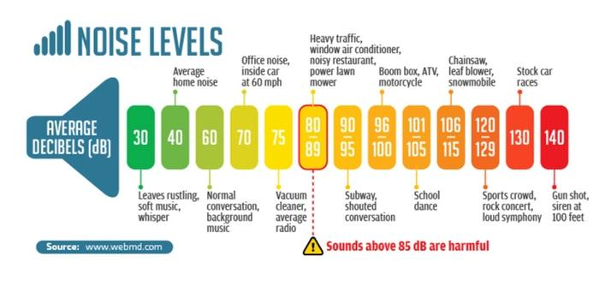
NOISE
Machine can be very loud – especially if ran for prolonged times

Slide 24
NOISE
So, what should I do?
  Wear ear plugs or ear muffs
  Avoid operating at the same time as someone else if possible

Slide 25
FIRE

Slide 26
FIRE
Several things in the shop can increase the incidence of a fire:
  Dust
  Friction causing heat
  Electricity
  Wood finishing chemicals

Slide 27
FIRE
So what should I do?
  Clean after each class period
  Unplug all machines
  Store chemicals properly
  Take frequent breaks to decrease heat caused by friction
  All rags used with stain or finish must be taken to the dumpster

Slide 28
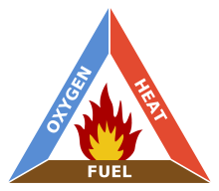
Fire Triangle

Slide 29
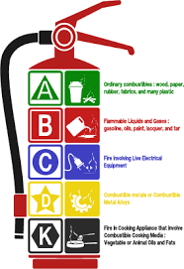
FIRE CLASSIFICATIONS
Class A: Solids (paper, wood, cloth)
Class B: Combustible liquids (gas, oil, paint thinner)
Class C: Electrical (switches, fuse boxes, motors)
Class D: Combustible metals (titanium, magnesium)

Slide 30
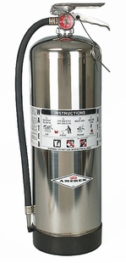
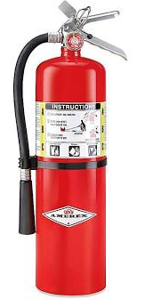
TYPES OF FIRE EXTINGUISHERS
Water (APW)
Carbon Dioxide (CO2)
Dry Chemical (ABC, BC, or DC)
Class D
Notes:
Water (APW)
-Air pressurized water, large and silver (2 ft tall, 25 lbs when full)
-Class A fires only
-Using water on a liquid fire could case fire to spread. Using water on electrical fire can result in electrocution.
-Eliminates HEAT element of fire triangle
Carbon Dioxide (CO2)
-Red, range in size from 5 to 100 pounds
-Class B (flammable liquid) and Class C (electrical fires) only
-Eliminates OXYGEN element of fire triangle
-CO2 is cold, so cools the fire as well
Dry Chemical (ABC, BC, or DC)
-Put out fire by coating fuel with a thin layer of dust, separating the fuel from the oxygen
-Will be labeled DC (Dry Chemical), ABC (Can be used on class A, B, or C fires), or BC (can be used on class B or C fires)
Class D
-Dry powder
-Similar to dry chemical except that they extinguish the fire by separating the fuel from the oxygen element or by removing the heat element of the fire triangle.
-For use on class D fires

Slide 31
FIRE EXTINGUISHERS
https://www.youtube.com/watch?v=PQV71INDaqY

Slide 32
GO FIND IT!
Where are the fire extinguishers located?
What type of fire extinguishers do we have?
What is the inspection date on the fire extinguishers?
Where are the fire exits located?
Where is the storage location for paints, stains, and finishes?

Slide 33
GO FIND IT!
Where are the sinks located to rinse a burn?
Where are the first aid kits located?
Where is a phone if 911 needs to be called?

Slide 34
HOUSEKEEPING

Slide 35
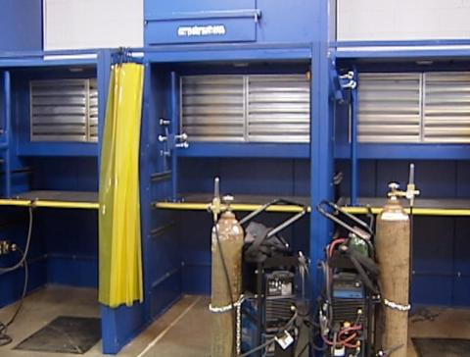
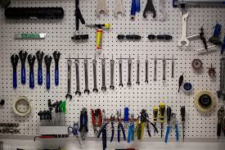
HOUSEKEEPING
Should be kept clean at all times
Combustibles (wood, paper, rags, and flammable liquid) should be kept clear of all equipment
All tools have their place

Slide 36
GO FIND IT!
Where are the brooms and dust plans kept?
Where are the hand tools kept?
Where should the sandpaper be stored?
Where should scrap wood be stored?
Where should screws, nails, etc be stored?
Where should the drill bits be stored?

Slide 37
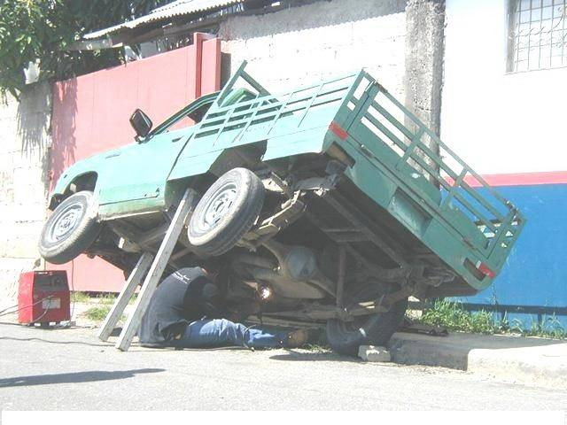

Slide 38
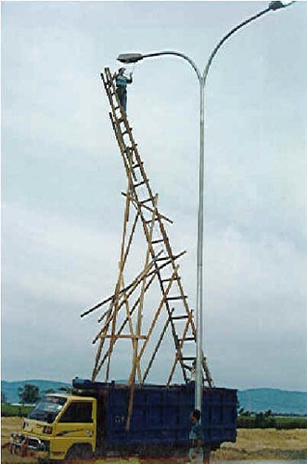

Slide 39
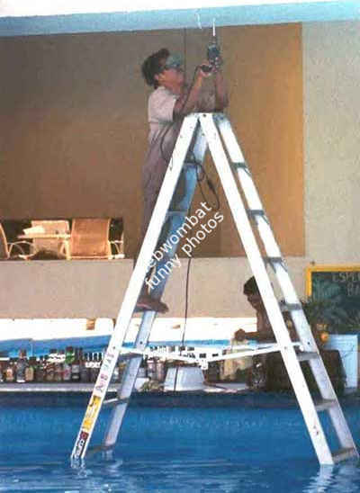

Slide 40
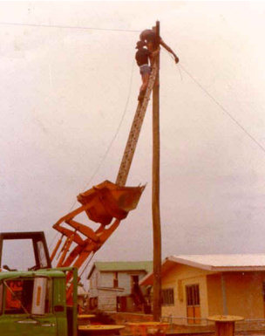

Slide 41
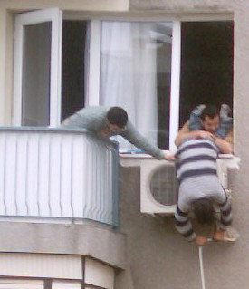

Slide 42
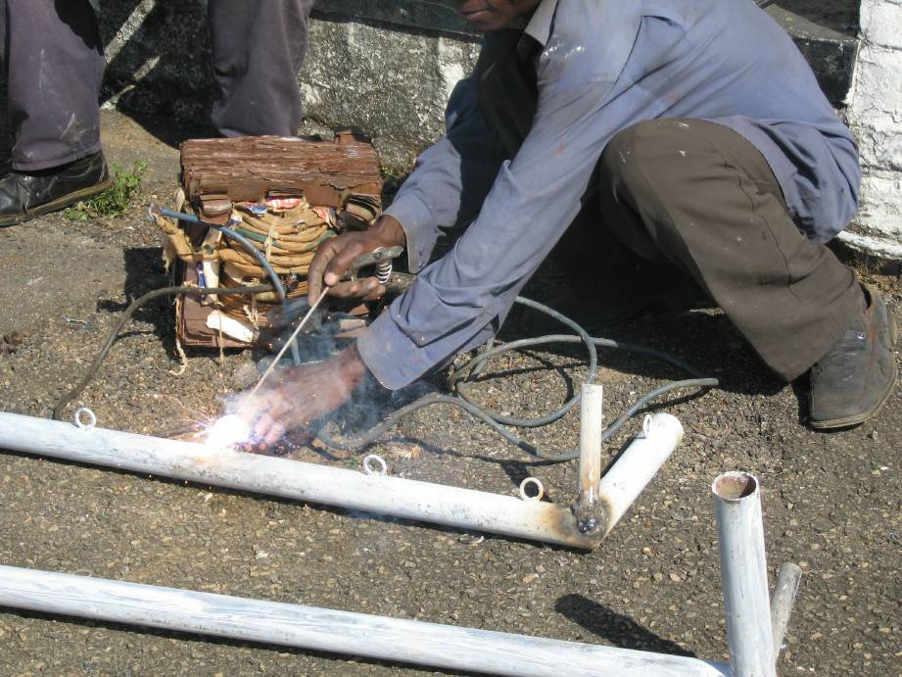

Slide 43
A Clean Shop Is
A Safe Shop

Slide 44
REPORT IMMEDIATELY
If anything occurs that may be unsafe or if you are injured, report to Mrs. Knabe immediately!!

