Slide 1
How does Soil Form?
Unit: Soil , Lesson 1

Slide 2
Objectives
Define the upper and lower limits of soil
Model the definition of four soil formation processes
List and describe the five soil formation factors

Slide 3
Soil Depth
Soil Depth is the part of the soil that supports plant growth
Upper Limit is the top of the soil where top soil meets the earth’s atmosphere.
Lower Limit is the area between the bottom of the soil and parent materials
Depth Class | Soil Depth
Very Deep | >60 inches
Deep | 40 inches - 60 inches
Moderate Deep | 20 inches - 40 inches
Shallow | 10 inches - 20 inches
Very Shallow | <10 inches

Slide 4
The Four Processes of Soil Formation
Transformation: Weather or breakdown of sand and formation of clay minerals, transformation of coarse organic matter into decay resistant organic compounds.
Translocation: Movement of soil parts within the profile and/or between horizons. Over time, this process is one of the more visibly noticeable as changes in color, texture, and structure become apparent.
Additions: Materials added to the soil, such as decomposing organic matter or new mineral materials deposited by wind or water.
Losses: Through the movement of wind or water, or uptake by plants, soil particles or chemical compounds can be eroded, leached, or harvested from the soil, altering chemical and physical makeup of the soil.

Slide 5
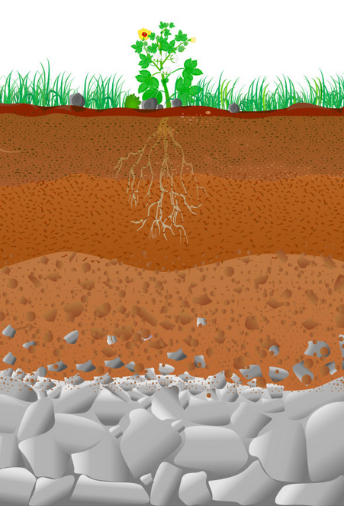
Wind Erosion
Decomposition
Nutrient Uptake
Weathering limestone

Slide 6
Five Factors in Soil Formation
Parent Material - Parent rock from which the soil is formed
Climate - Precipitation and temperature determine soil
Topography - The lay of the land influences erosion
Biological Factors - Organisms have a major part in soil formation
Time - It requires many years for soil to form

Slide 7
Parent Material
Parent rock which a soil is formed helps determine soil characteristics.
Parent materials influence the formation of soils by their rates of weathering, the nutrients that they supply, and the particle sizes that they contain.
A young soil is more influenced by the parent material characteristics than mature soils.
Particle size has an impact on the properties of soil in the field.

Slide 8
Climate
Climate is a dominant factor in the formation of soils. Climate determines soil.
The two most important components of climate that affect soil are precipitation and temperature.
In areas of high rainfall there is intense weathering and leaching resulting in acid soils as lime in leached through the soil.
Erosion of sloping lands remove top layers of soil and deposits them down slope.
Changes in temperature strongly affect the rate of weathering. Different rates of expansion and contraction bring about cracking and peeling beginning the breakdown of parent rock.

Slide 9
Biological Factors
Living plants and animals have major significance in the development of soil.
The type and amount of organisms present are influenced by climate.
Microorganisms help develop soils by decomposing organic matter and forming weak acids that dissolve minerals faster than would pure water.

Slide 10
Topography
Due to erosion, hill sides typically have thinner A and B horizons than more level areas, given the same parent materials and climate.
Soils on flat areas will have more water passing through them vertically than soils on steeper slopes and can often be more leached.
The profile on gentle slopes will be generally deeper, sustain more luxuriant vegetation, and contain more organic matter than soil profiles on steeper slopes.
In our hemisphere soils on west and south facing slopes receive more direct rays from the sun. Therefore, are warmer and drier than east and north facing slopes.

Slide 11
Time
It requires time, up to about a million years, to form soils.
Rocks like granite are extremely hard to decompose and softer rocks such as limestone take less time.
As soils age they differentiate into defined profiles consisting of three different layers (A horizon, B horizon, and C horizon).
A recognizable soil profile may develop in as few as 200 years or, under less favorable conditions, take several thousand years to develop.

